Slide 1
A strategic east–west connection shaping
Northern Europe

Slide 2
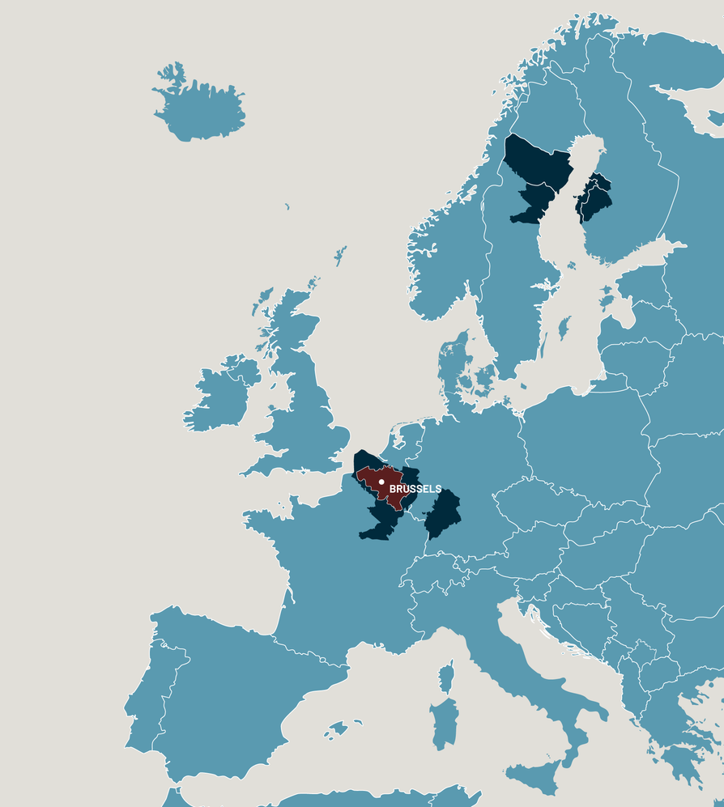
The Kvarken Council EGTC
European Grouping of Territorial Cooperation
A cross-border platform
Main members of the Kvarken Council
(with voting rights)
Region Västerbotten
Umeå Municipality
Örnsköldsvik Municipality
The Regional Council of Ostrobothnia
The Regional Council of South Ostrobothnia
The Regional Council of Central Ostrobothnia
City of Vaasa
City of Kokkola
City of Seinäjoki
City of Jakobstad
City of Kurikka
Korsholm Municipality
Storuman Municipality
Lycksele Municipality
Skellefteå Municipality
Region Västernorrland
Other municipal members
Vindeln Municipality
City of Nykarleby
City of Närpes
Nordmaling Municipality
Vännäs Municipality
Larsmo Municipality
Kronoby Municipality
Sundsvall Municipality
City of Kauhava
Lappajärvi Municipality
Robersfors Municipality
Pedersöre Municipality
Organisational members
Vaasa Region Development Company VASEK
Vaasa University of Applied Sciences
University of Vaasa
Jakobstad Region Development Company Concordia
Into Seinäjoki
Kristinestads näringslivscentral/
Kristiinankaupungin elinkeinokeskus
Hanken School of Economics
Umeå University
Mid Sweden University
Novia University of Applied Sciences
Seinäjoki University of Applied Sciences
Åbo Akademi
Federation of Swedish Municipalities
in Ostrobothnia for Education and
Culture (SÖFUK)
Metsähallitus
Centria
The size of our region compared to Belgium
A total of 43 members

Slide 3
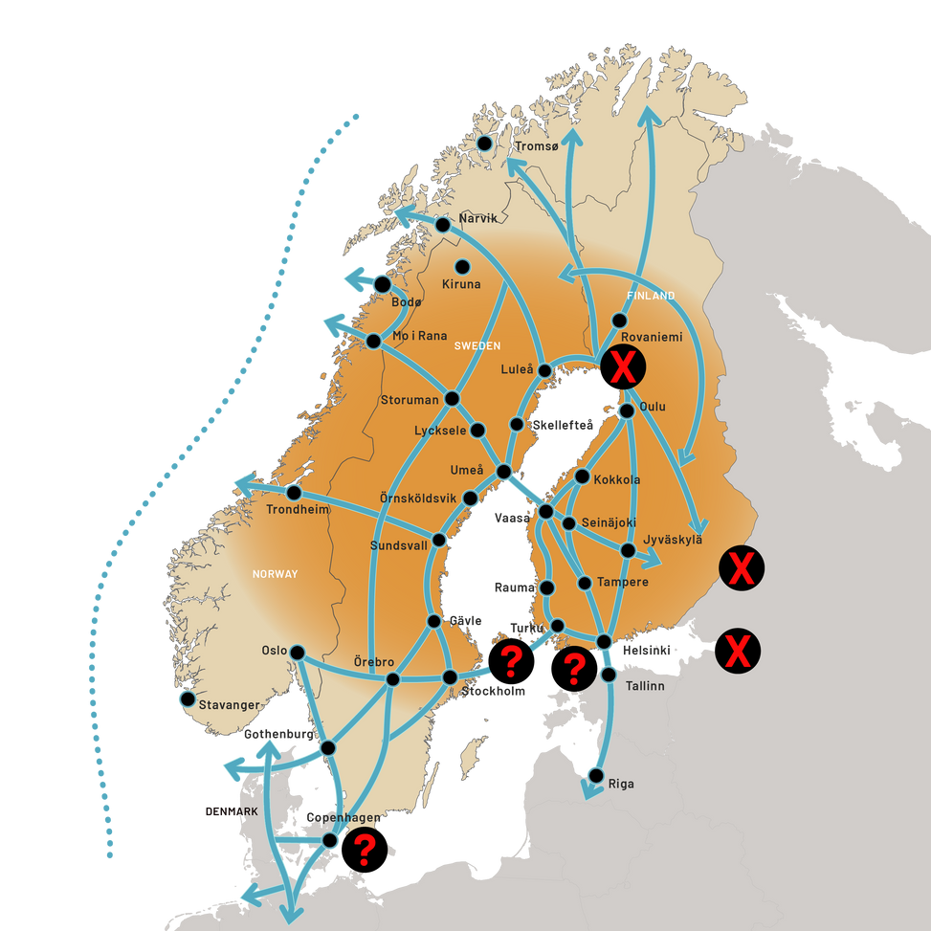
Current context
What if the Baltic Sea routes were blocked?
90% of Finnish and Swedish trade goes by sea
Shared border with Russia: 1,340 km
Limited east–west capacity
Disruptions expose critical vulnerabilities

Slide 4
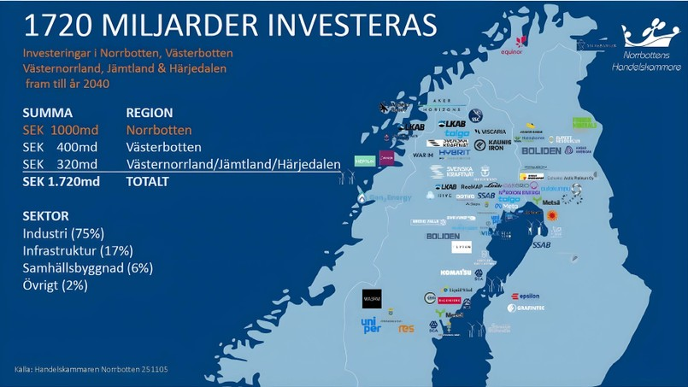
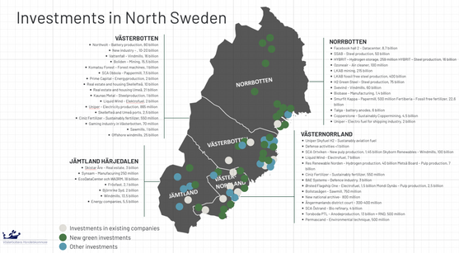
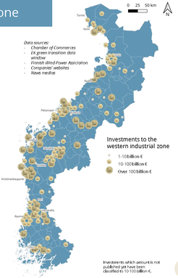
Why this matters now?
A transforming Northern Europe
Increasing pressure on European supply chains
  Rapid industrial and energy transformation
  Investments exceeding €200 billion by 2035
  The region provides critical raw materials
  for all of Europe
Food, energy and industrial supply chains
depend on reliable transport
Finland and Sweden are now NATO members
Data sources: Chamber of Commerces

Slide 5
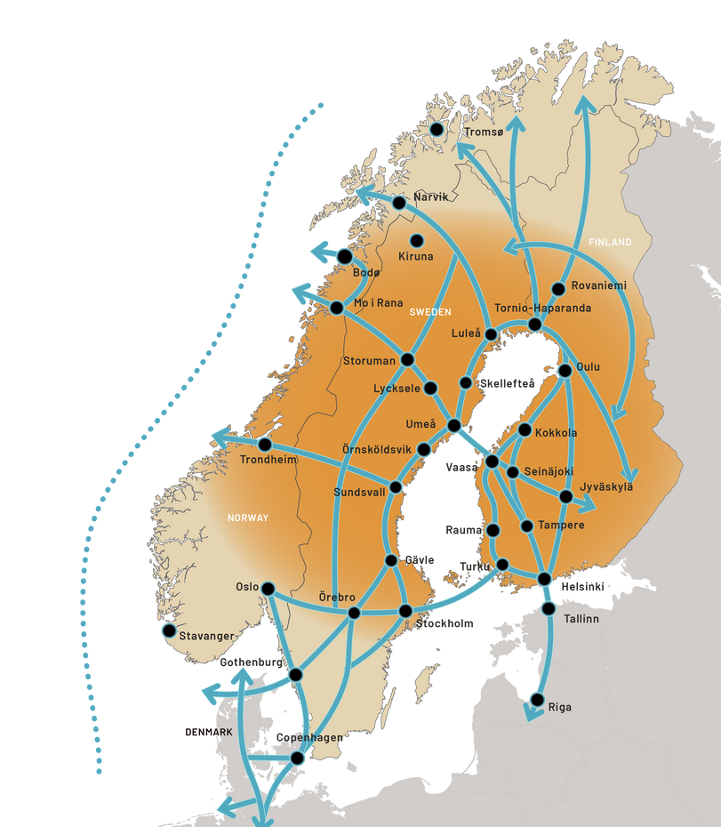
Nordic Connector
A strategic east–west connection for a stronger Northern Europe
Connecting northern Norway, Sweden and Finland
A fixed link across the Kvarken as a key component
  Strengthening resilience, security of supply and competitiveness
  Connecting Northern Europe to Atlantic ports and wider markets
  Strengthening connections between Nordic and European transport systems
Not an end in itself – a tool for wider societal benefits

Slide 6
What Nordic Connector enables
Industry and growth
  Strengthens competitiveness and supports major investments
Logistics and efficiency
  Shorter routes and fewer transhipments
  Lower costs for industry
Sustainability
  Lower CO₂ emissions
People and society
  Increased labour mobility
  Stronger links in education, research and healthcare
System resilience
  Improved energy security
  Stronger, two-way east–west transport system
  Improved access to Atlantic ports and Arctic shipping routes

Slide 7
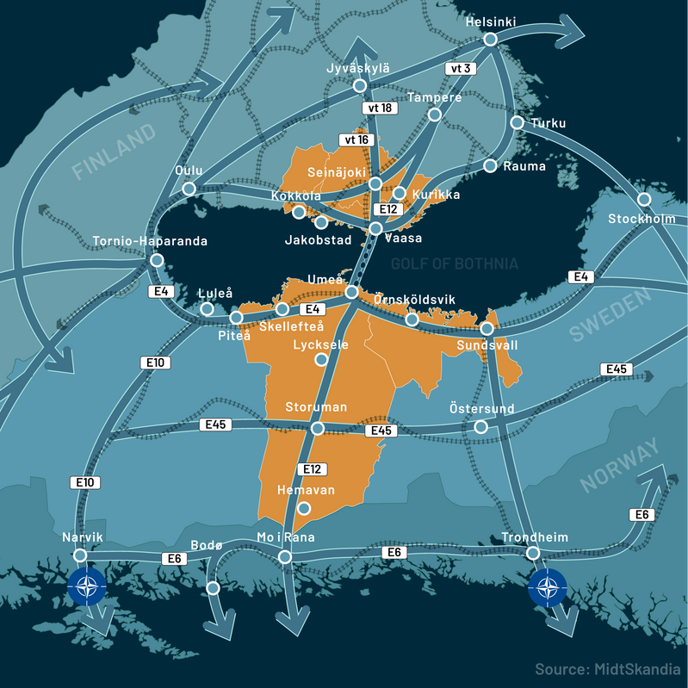
Progress and political momentum
Included in the Finnish Government Programme
Included in Finland’s national transport plan
(Liikenne 12, 2021–2032)
Feasibility confirmed by the Finnish Transport
Infrastructure Agency
Highlighted by the Finnish Defence Committee and
approved by the Finnish Parliament
Nordic Council (2025): recommendation to
work on east–west connections
Presented in the Swedish Parliament
Growing interest at Nordic and European levels

Slide 8
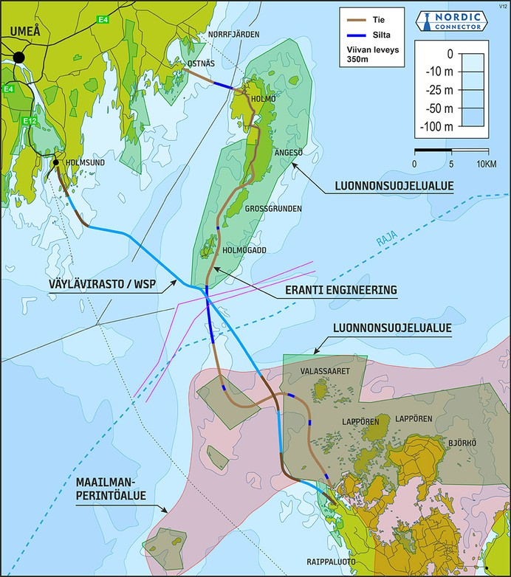

Technical and financial perspective
A fixed link across the Kvarken
Combination of road sections, causeways, bridges and tunnels
Estimated cost range: €5–29 billion
Feasibility confirmed – financing under analysis
Financing models under analysis, including
cross-border approaches, wider societal
benefits and security and military mobility
(FLINC project)
25 km between the outermost islands
Kvarken is the shallowest part of the Gulf of Bothnia
(20–25 m on average, up to ~100 m)
Source: Esa Eranti and Antti Tavitie, www. erantiengineering.fi

Slide 9

FLINC – Analysis of financing and societal benefits
Financing large-scale cross-border infrastructure - Case Nordic Connector
Develops methodologies for financing large-scale cross-border infrastructure
Analyses wider societal impacts beyond traditional cost–benefit frameworks
Conducts in-depth analysis of military mobility
  Objective: support future political decision-making
Funding: Interreg Aurora (EU), Lapland Regional Council, Finnish Transport Infrastructure Agency, City of Vaasa,
Umeå Municipality
The reference group includes representatives from, among others, the Finnish Transport Infrastructure Agency,
Traficom, and the Swedish Transport Administration.
Lead partner: Kvarken Council EGTC

Slide 10
Key messages
Not only a regional project
A strategic investment for Finland, Sweden and Europe
Strengthens resilience and security of supply
Supports military mobility
Strengthens Nordic and European transport networks through new east–west connections
Enhances competitiveness
Technically feasible
Initial estimates suggest the project could fully
or partly pay for itself
Wider benefits analyses confirm a sound investment
despite high costs
Clear strategic value for military mobility,
preparedness and food security

Slide 11

Thank you!
Follow our results
kvarken.org
facebook.com/kvarkenradet
linkedin.com/company/kvarkencouncil

